Slide 1
FEATURE SQUEEZING: DETECTING ADVERSARIAL EXAMPLES IN DEEP NEURAL NETWORKS
ACS 54500: CRYPTOGRAPHY AND NETWORK SECURITY
Author: Weilin Xu, David Evans, Yanjun Qi
Research Paper Presentation
Spring 2024
Presenter:
Fairuz Haq
Vijayagiridharan Subramanian

Slide 2
Outline
Background and Research Problem Studied
Approach Applied
Main Contributions
Re-implementation
Enhancement Beyond the Work
Learning from the Research Paper

Slide 3
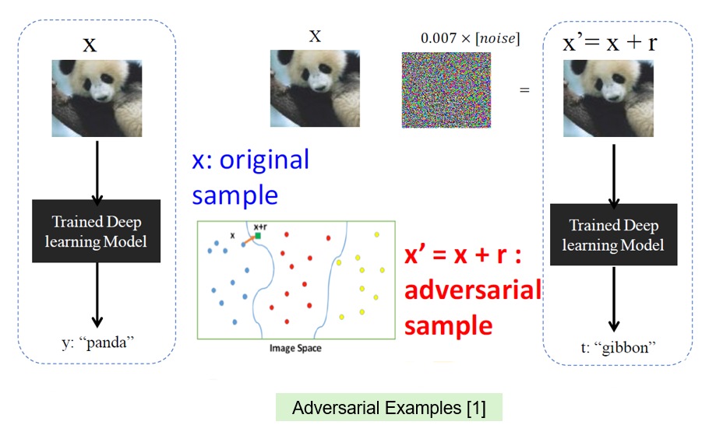
Background and Research Problem Studied
Original sample is correctly classified as a panda by a trained deep learning model.
Adversarial example is generated by adding very little noise to original sample.
Adversarial example is visually similar to panda but misclassified as a gibbon.

Slide 4
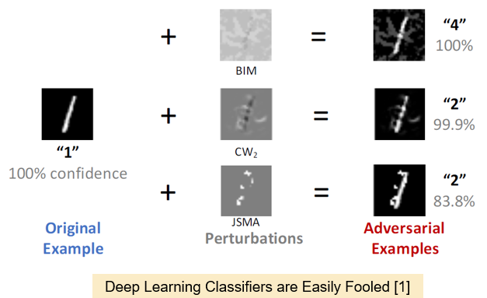
Background and Research Problem Studied
Different perturbation noises are added to original image separately that generate different adversarial examples.
Adversarial examples are misclassified differently by same trained deep learning model
Deep learning classifiers are affected easily and predicts misclassified results

Slide 5
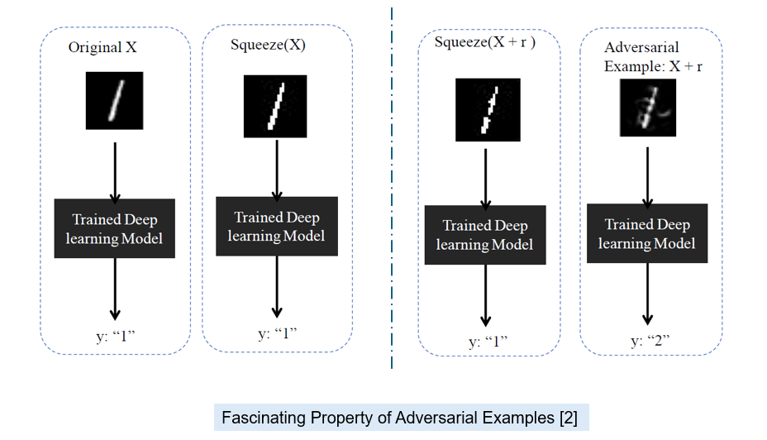
Approach Applied: Property of Adversarial Example
Same deep learning model is used in all case.
Adversarial example is generated by adding very small noise to original image.
Same squeezer is used on both original image and adversarial example.

Slide 6
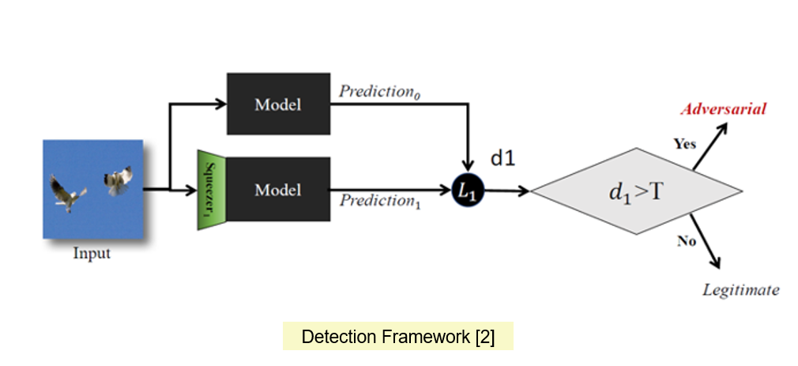
Approach Applied: Detection Framework

Slide 7
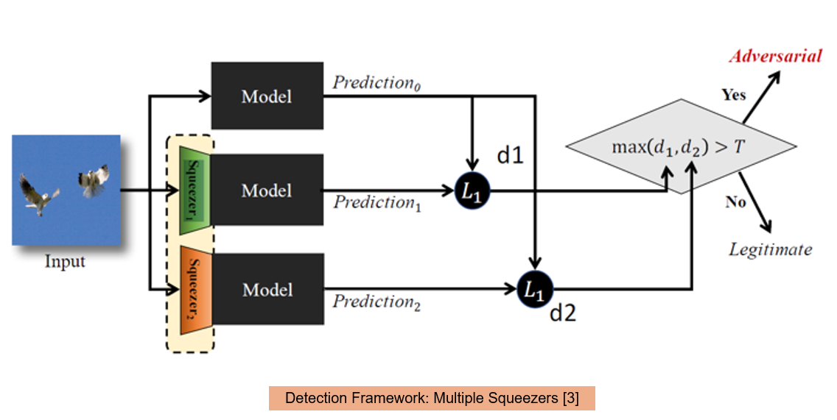
Approach Applied: Multiple Squeezers

Slide 8
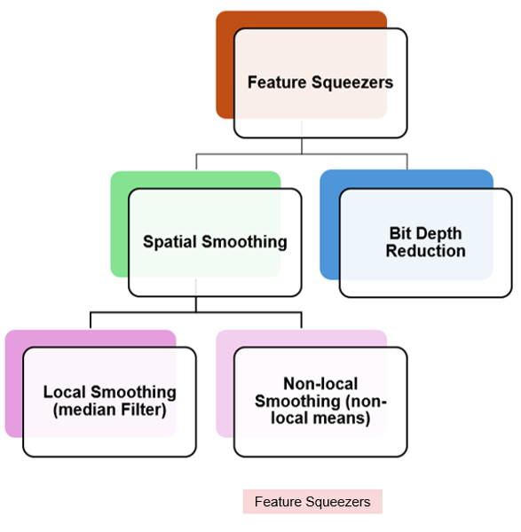
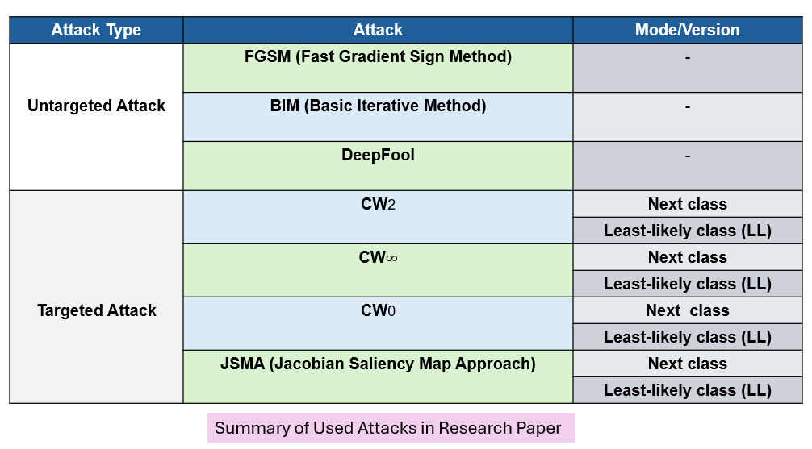
Approach Applied: Feature Squeezers & Attacks

Slide 9
Main Contributions
Feature squeezing technique is introduced and evaluated for detecting adversarial examples.
Since feature squeezing technique does not change the underlying model, therefore it is complementary to other adversarial defenses.

Slide 10
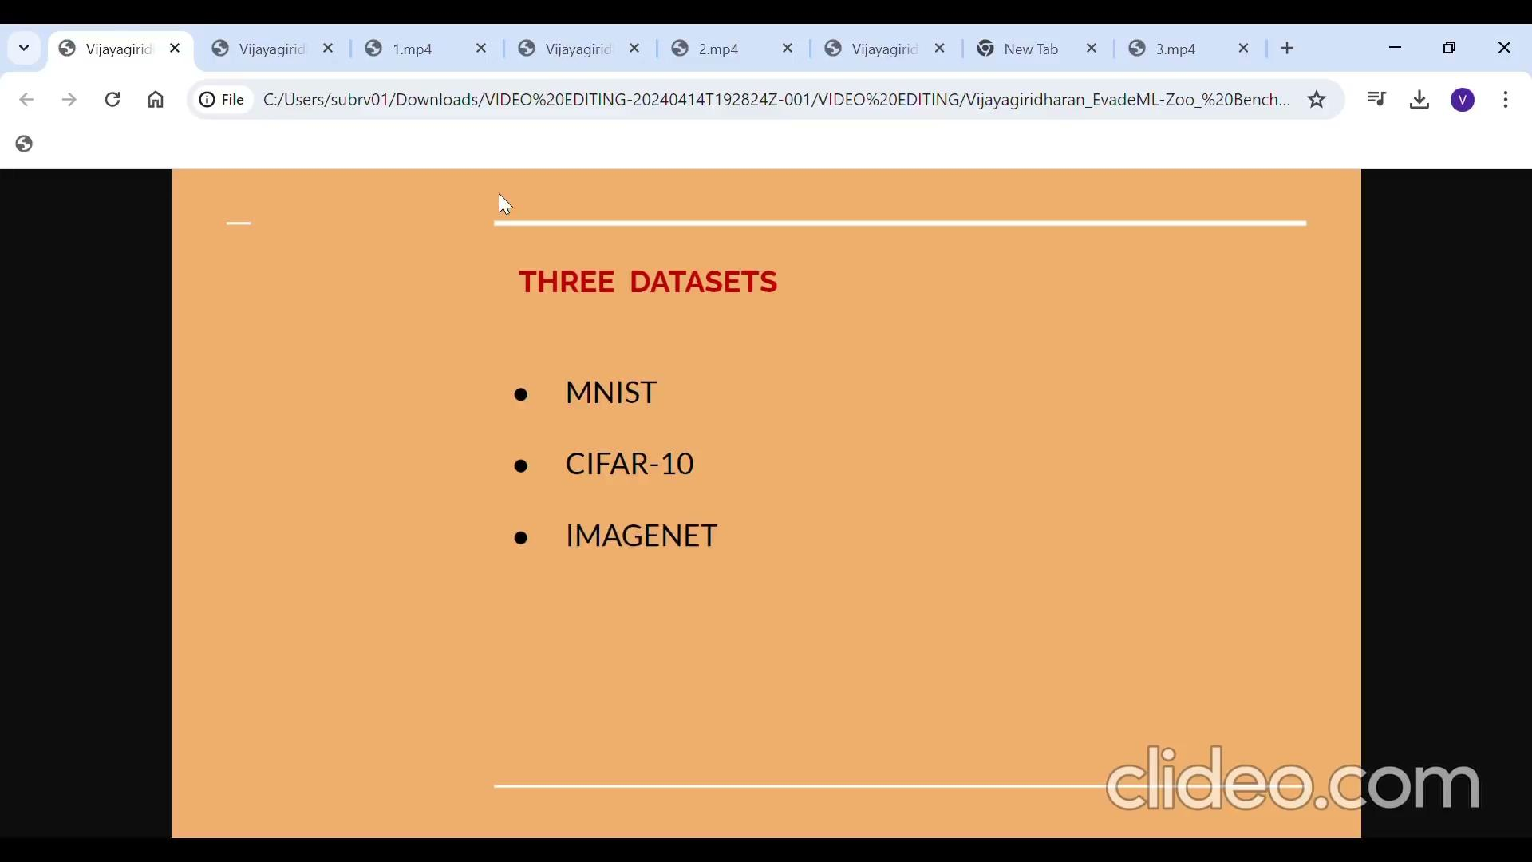
Re-implementation: Video
https://drive.google.com/file/d/13N0iChCFC7nsFvjDm2QBIWqFjcsTBfRU/view?usp=drive_link

Slide 11
Re-implementation: Code
You can find the existing working code on:
https://github.com/Vijayagiridharan/EvadeML-Zoo

Slide 12
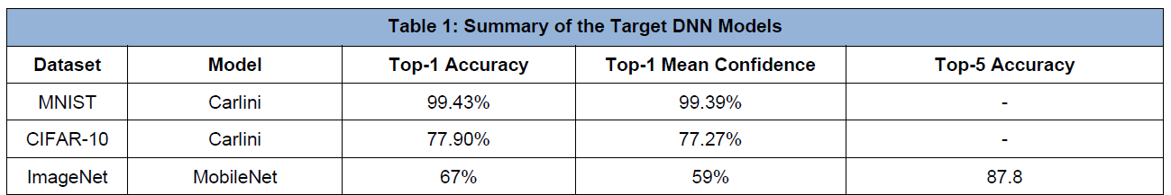
Re-implementation: Target DNN Models

Slide 13
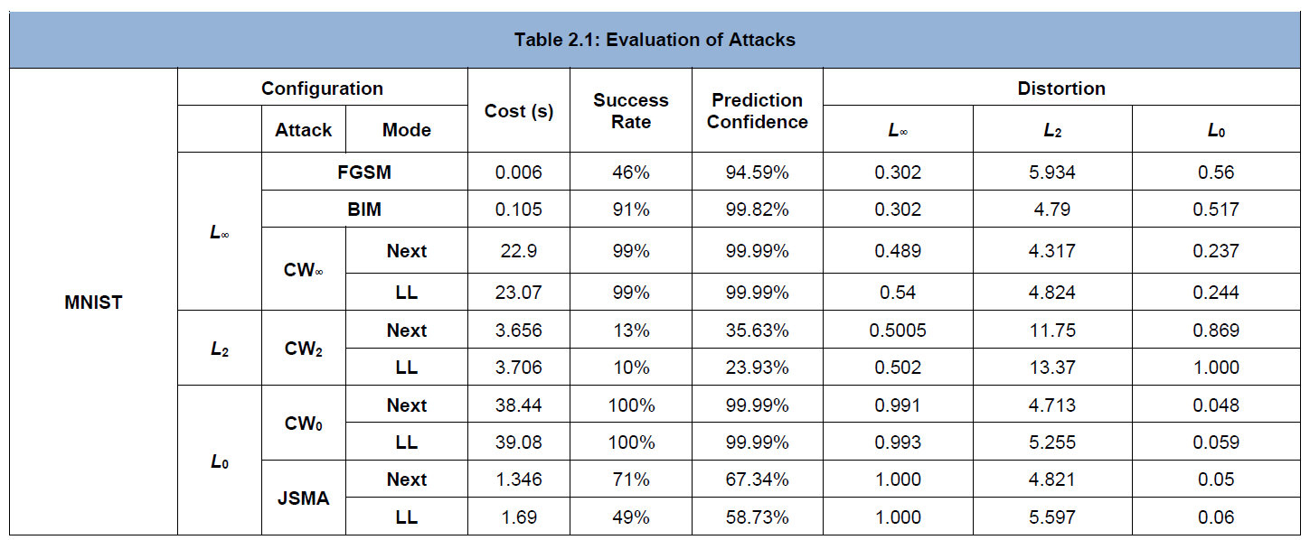
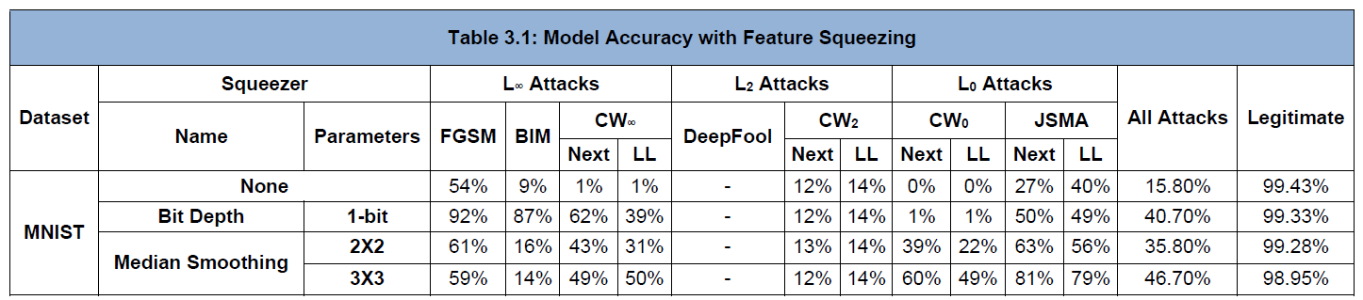
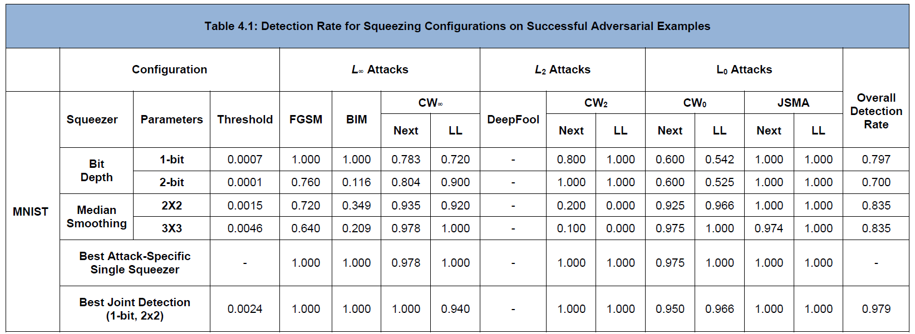
Re-implementation: MNIST

Slide 14
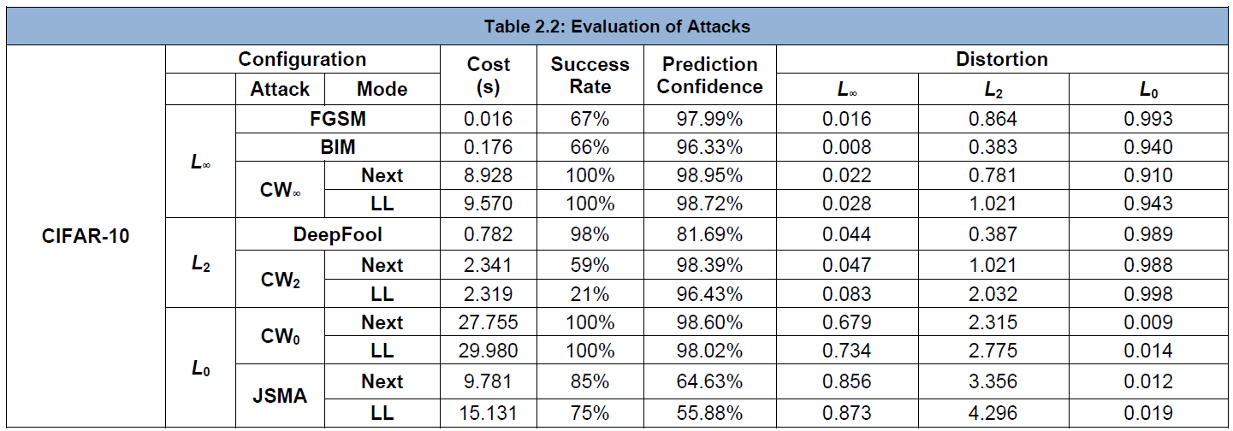
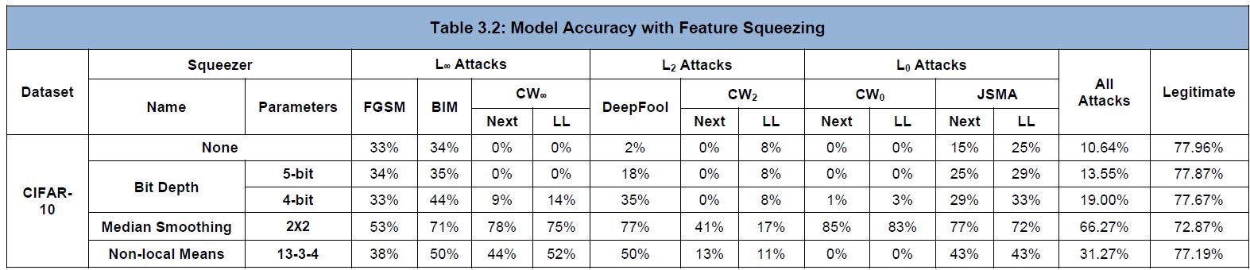
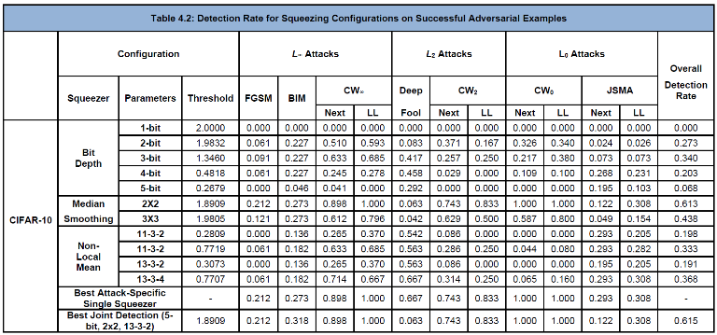
Re-implementation: CIFAR-10

Slide 15
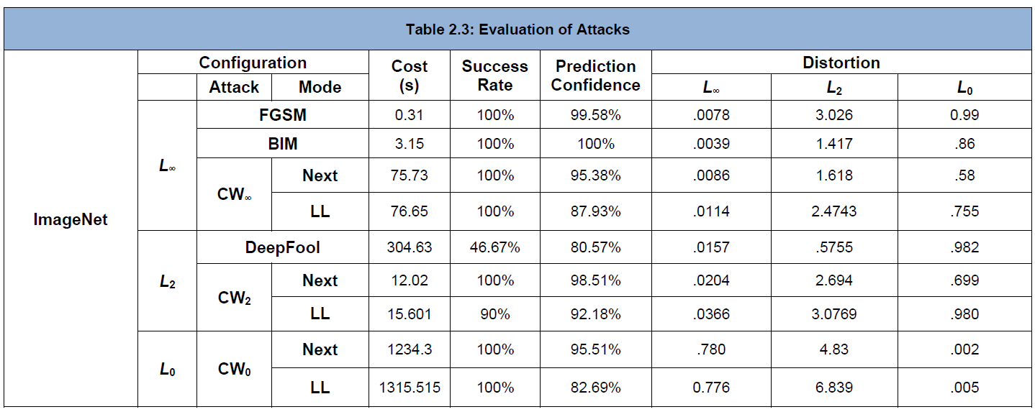
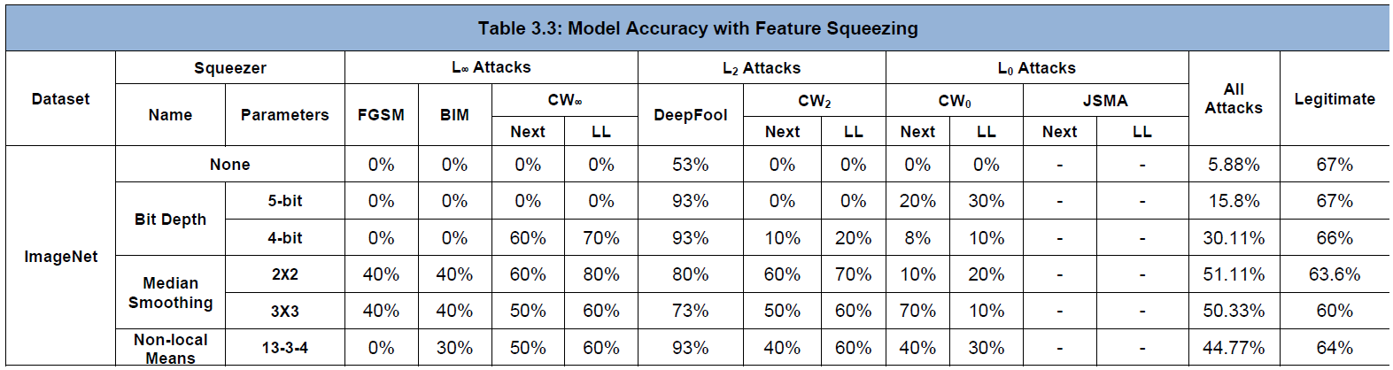
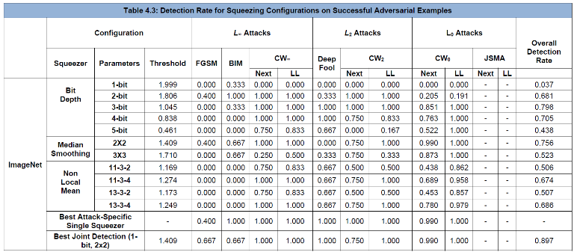
Re-implementation: ImageNet

Slide 16
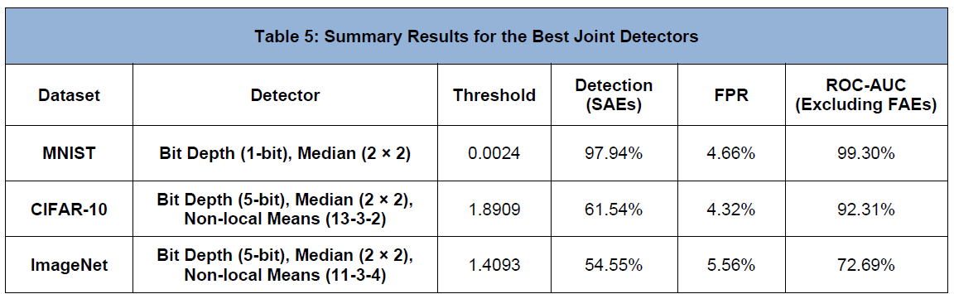
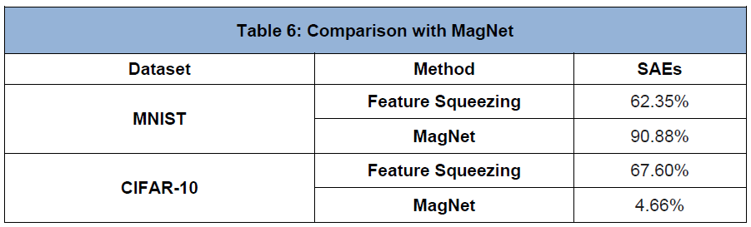
Re-implementation: Summary & Comparison

Slide 17
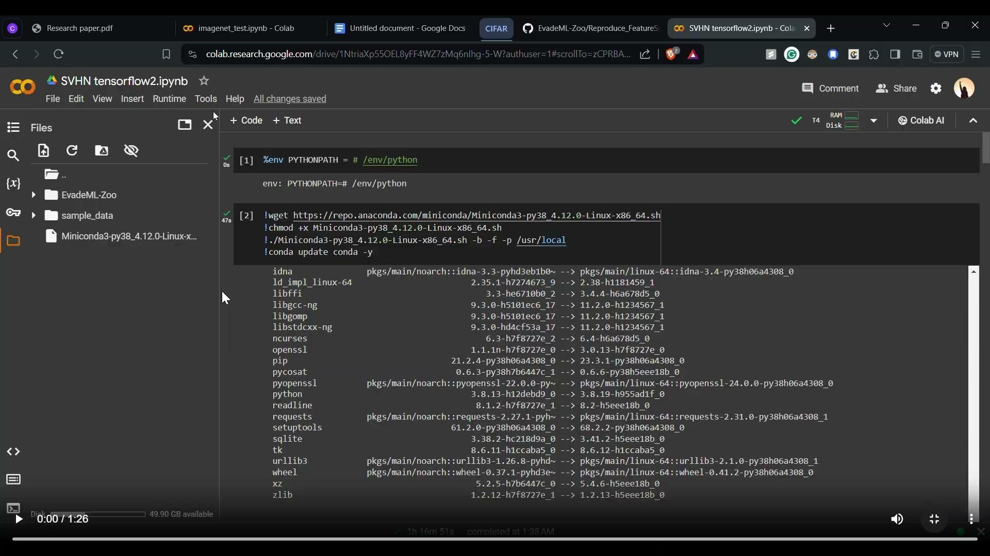
Enhancement Beyond the Work: Video
https://drive.google.com/file/d/1EQ9NGeFtA-rHucG3TsCoGzSYRZuoEPYT/view?usp=drive_link

Slide 18
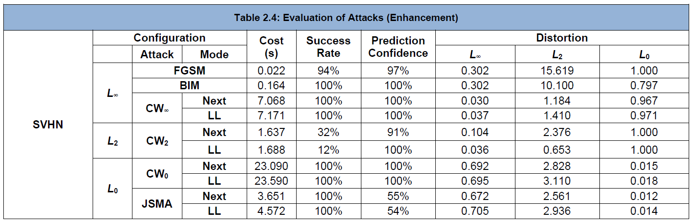
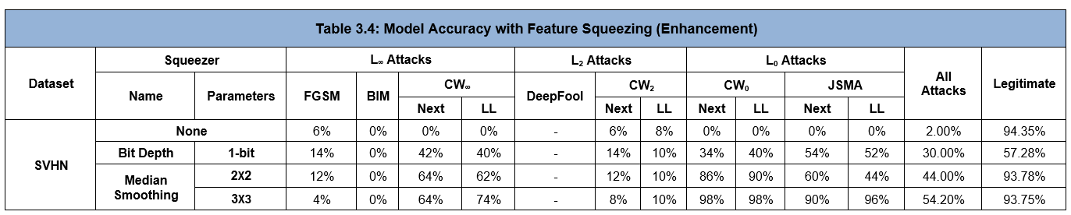
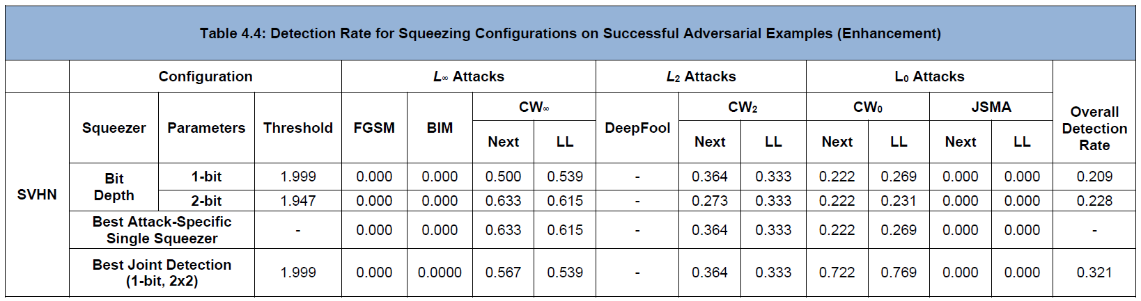
Enhancement Beyond the Work

Slide 19
Learning from the Research Paper
Feature Squeezing provides a framework that reduces the search space available for an adversary and detects adversarial examples.
Feature squeezing hardens deep learning models.
The effectiveness of feature squeezing is surprising since it is so simple and inexpensive compared to other proposed defenses.
It helps DNN models to predict correct classification on adversarial examples generated by eleven different attacks executed without knowledge of the defense.
It complicates the task of an adaptive adversary even with full knowledge of the model and defense.

Slide 20
Reference
[1] C Szegedy et al., Intriguing Properties of Deep Neural Networks. In ICLR 2014.
[2]chrome-extension://efaidnbmnnnibpcajpcglclefindmkaj/https://qdata.github.io/secureml-web/pic/18Webnar_feature_squeezing-V2.pdf
[3] Xu, Weilin, David Evans, and Yanjun Qi. "Feature squeezing: Detecting adversarial examples in deep neural networks." arXiv preprint arXiv:1704.01155 (2017).
[4] Code: https://github.com/mzweilin/EvadeML-Zoo
[5] https://www.youtube.com/watch?v=GkJdnvJ6j_k&t=244s&ab_channel=NDSSSymposium\
[6] https://www.youtube.com/watch?v=pFZaktfRdss&t=589s&ab_channel=YanjunQi

Slide 21


Slide 22

Questions?

